Slide 1
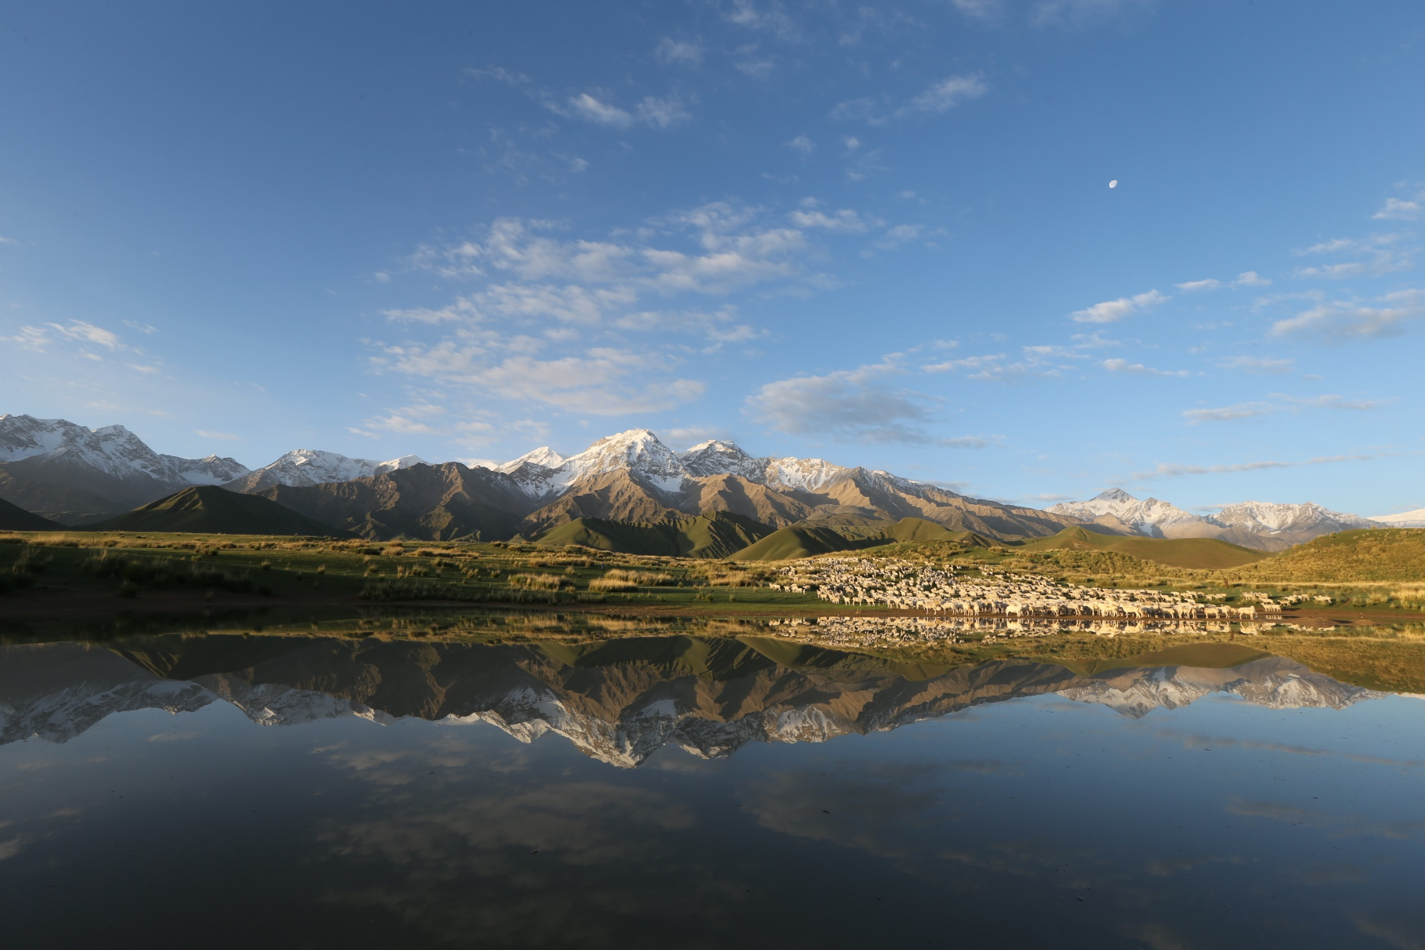
着力生态环境建设
全力打造全球低碳景区
Focus on ecological environment construction
Make every effort to build a global low-carbon scenic spot
昆牧镇 陈 方

Slide 2
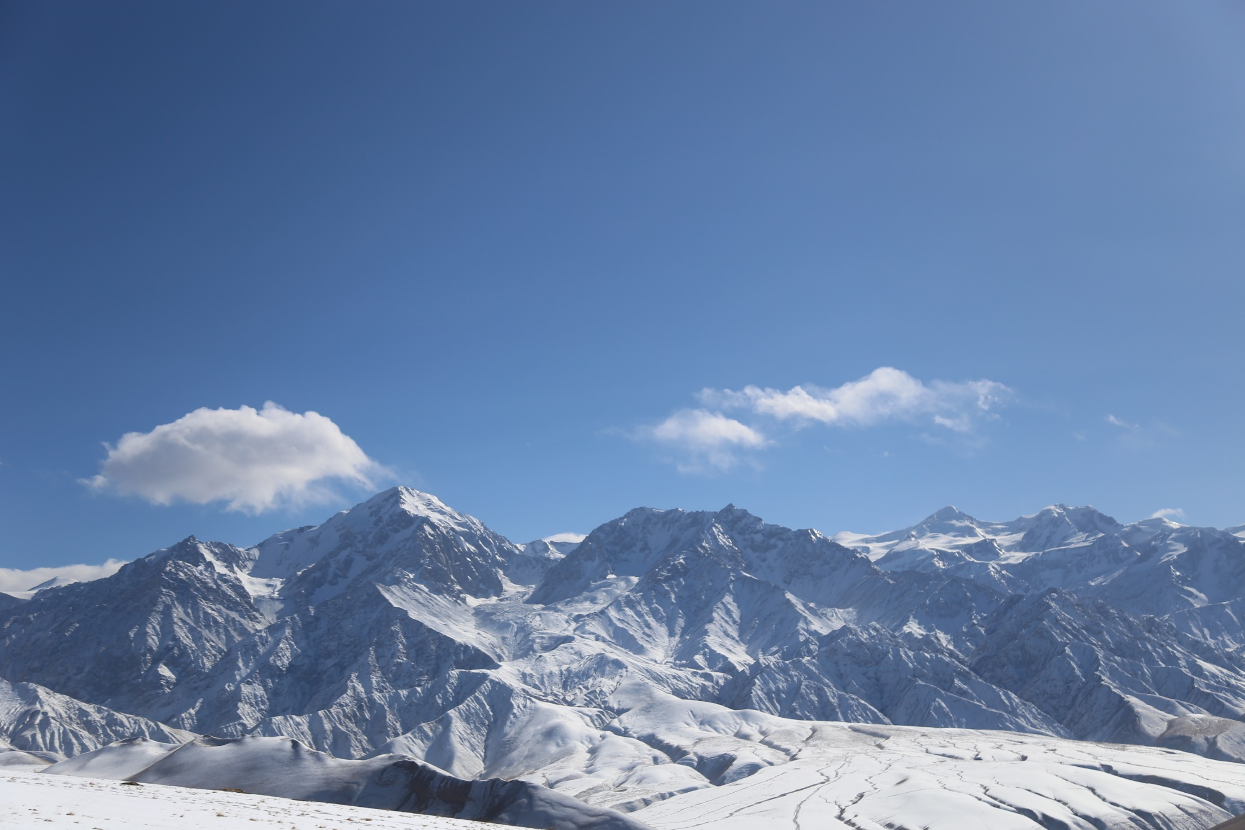
从华夏伊始便存在
It has existed since the beginning of China

Slide 3
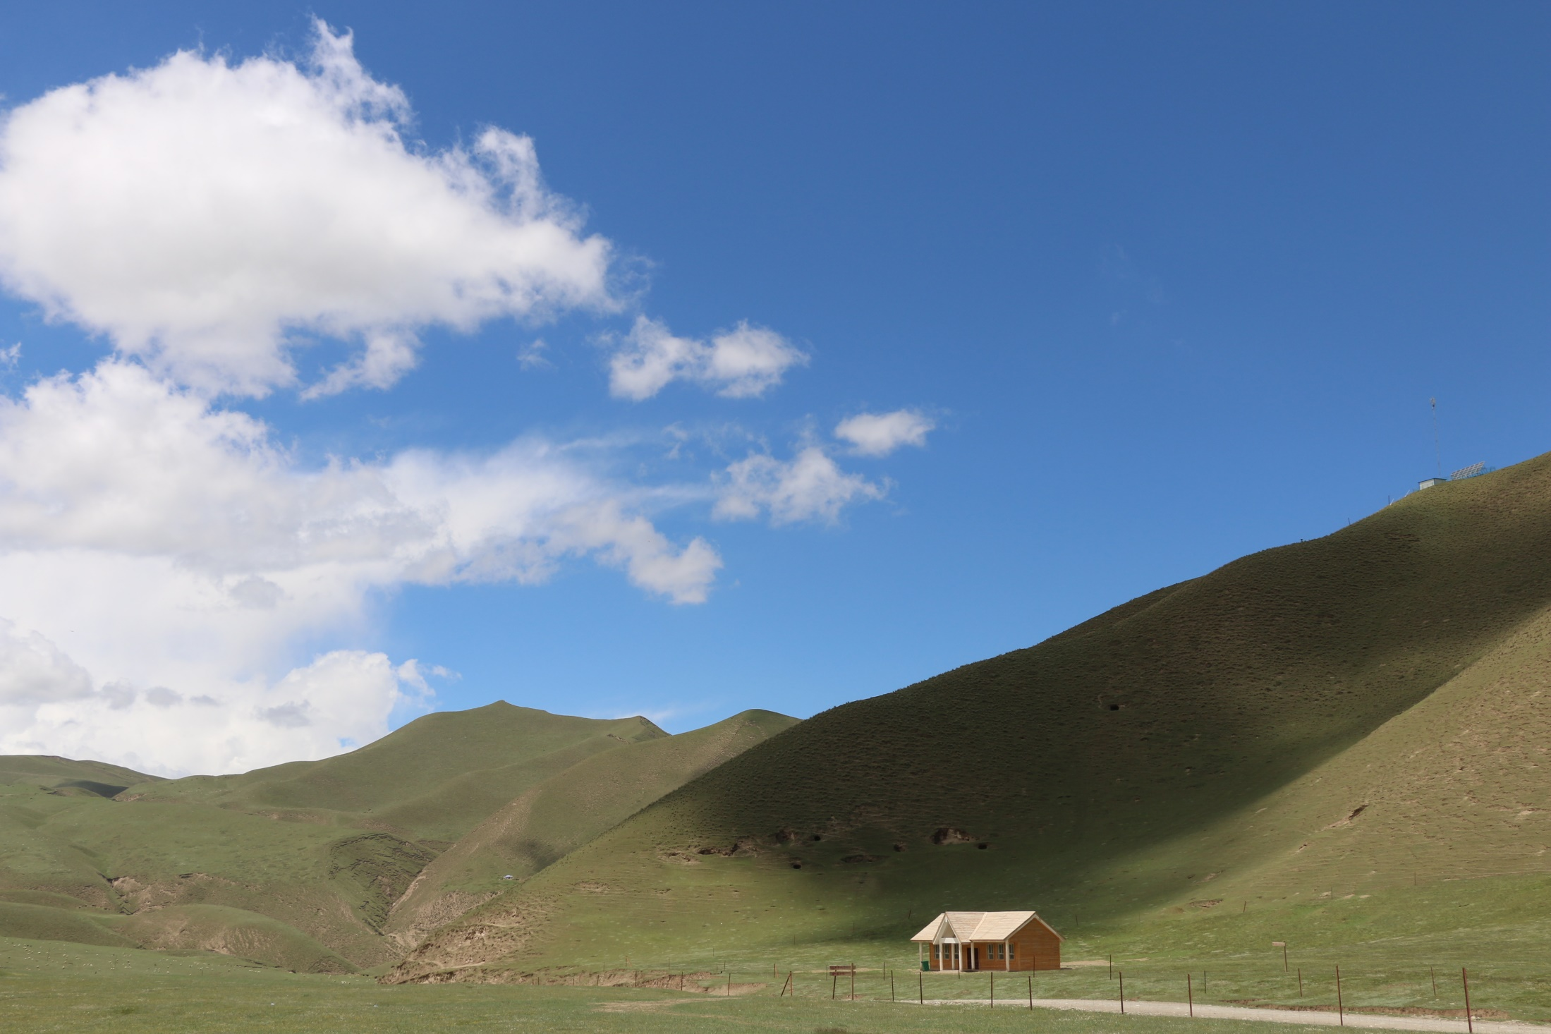
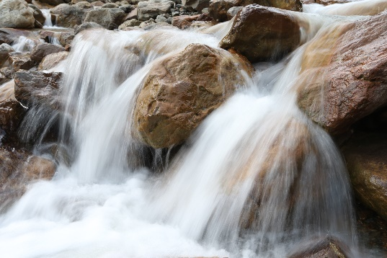
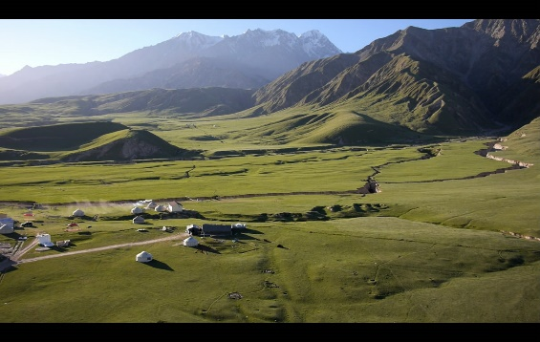
美丽的风景
清洁的环境
潺潺的流水
Beautiful scenery
clean environment
gurgling water

Slide 4
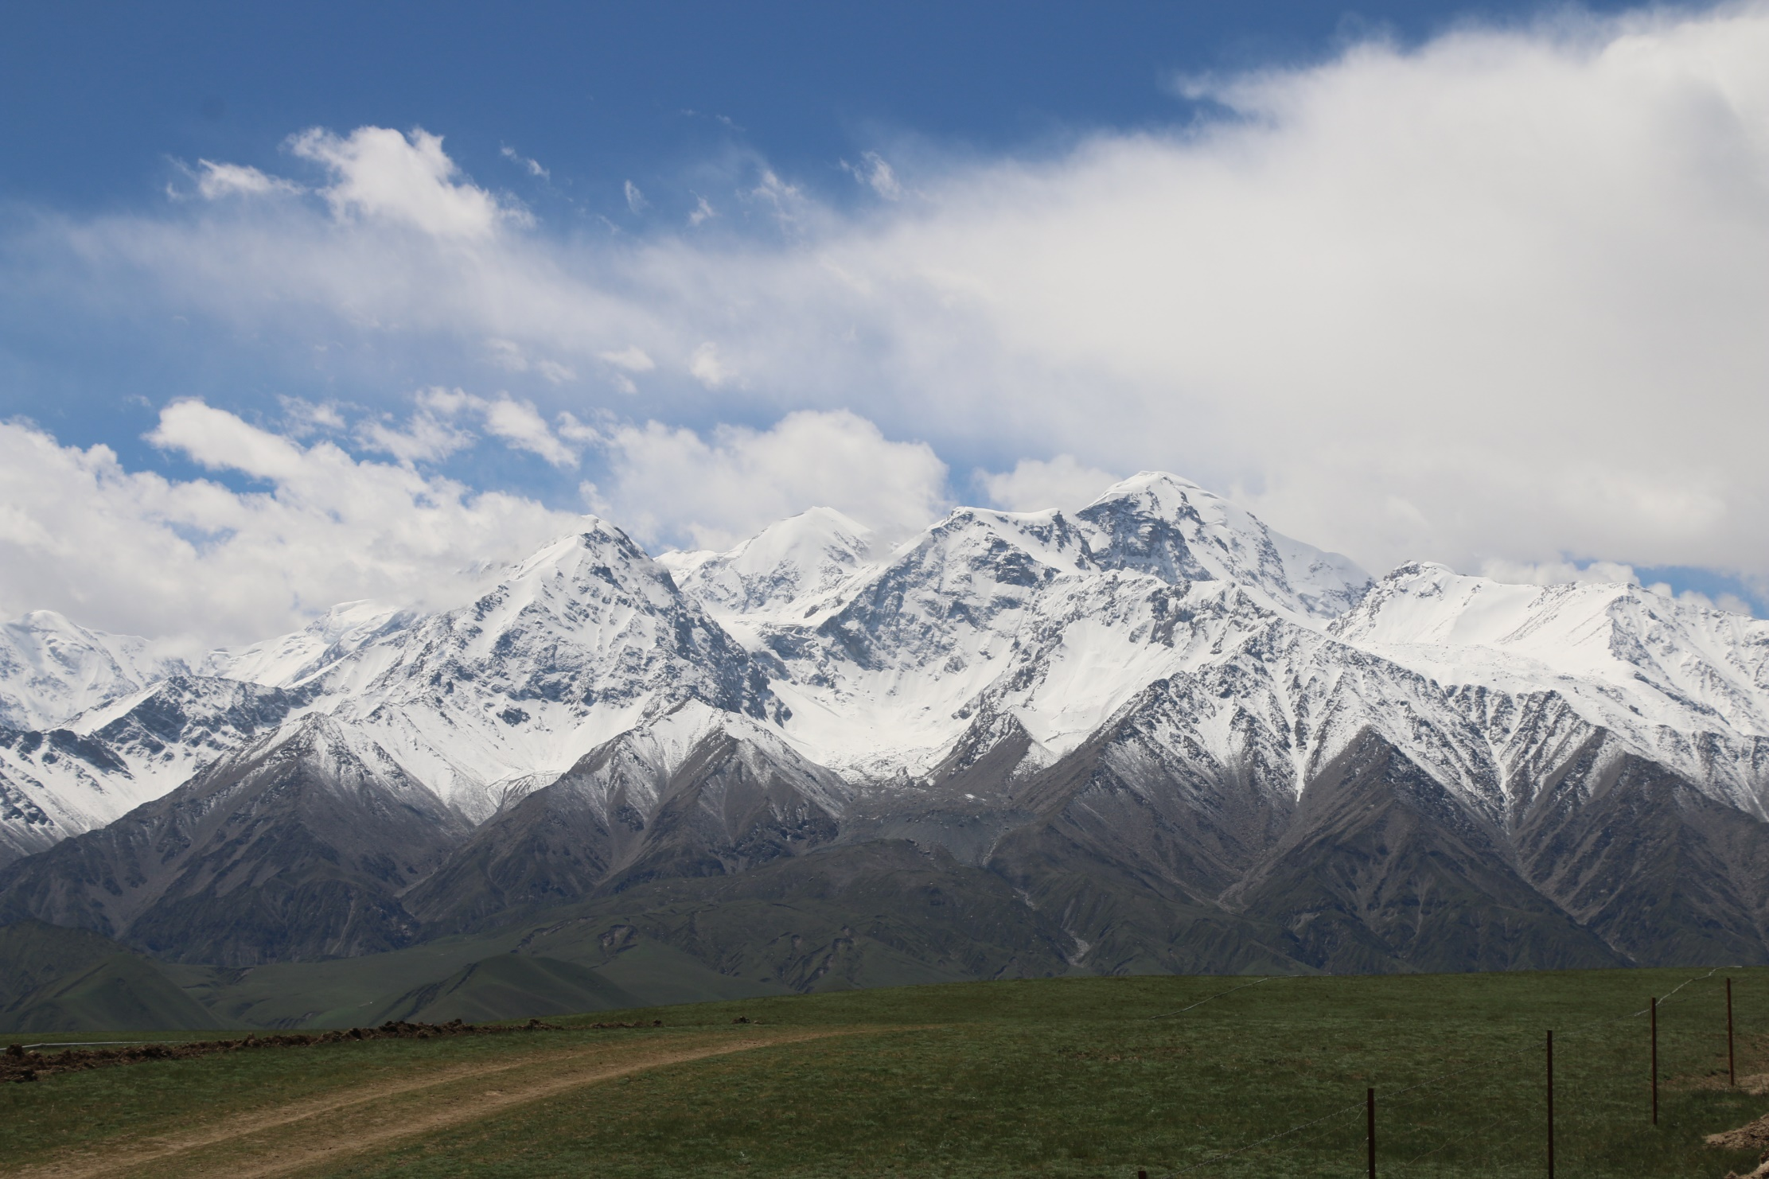
风景秀丽 环境优美
Beautiful scenery and beautiful environment
国家AAAA级景区
National AAAA level scenic spot
国家草原自然公园
National Grassland Nature Park

Slide 5
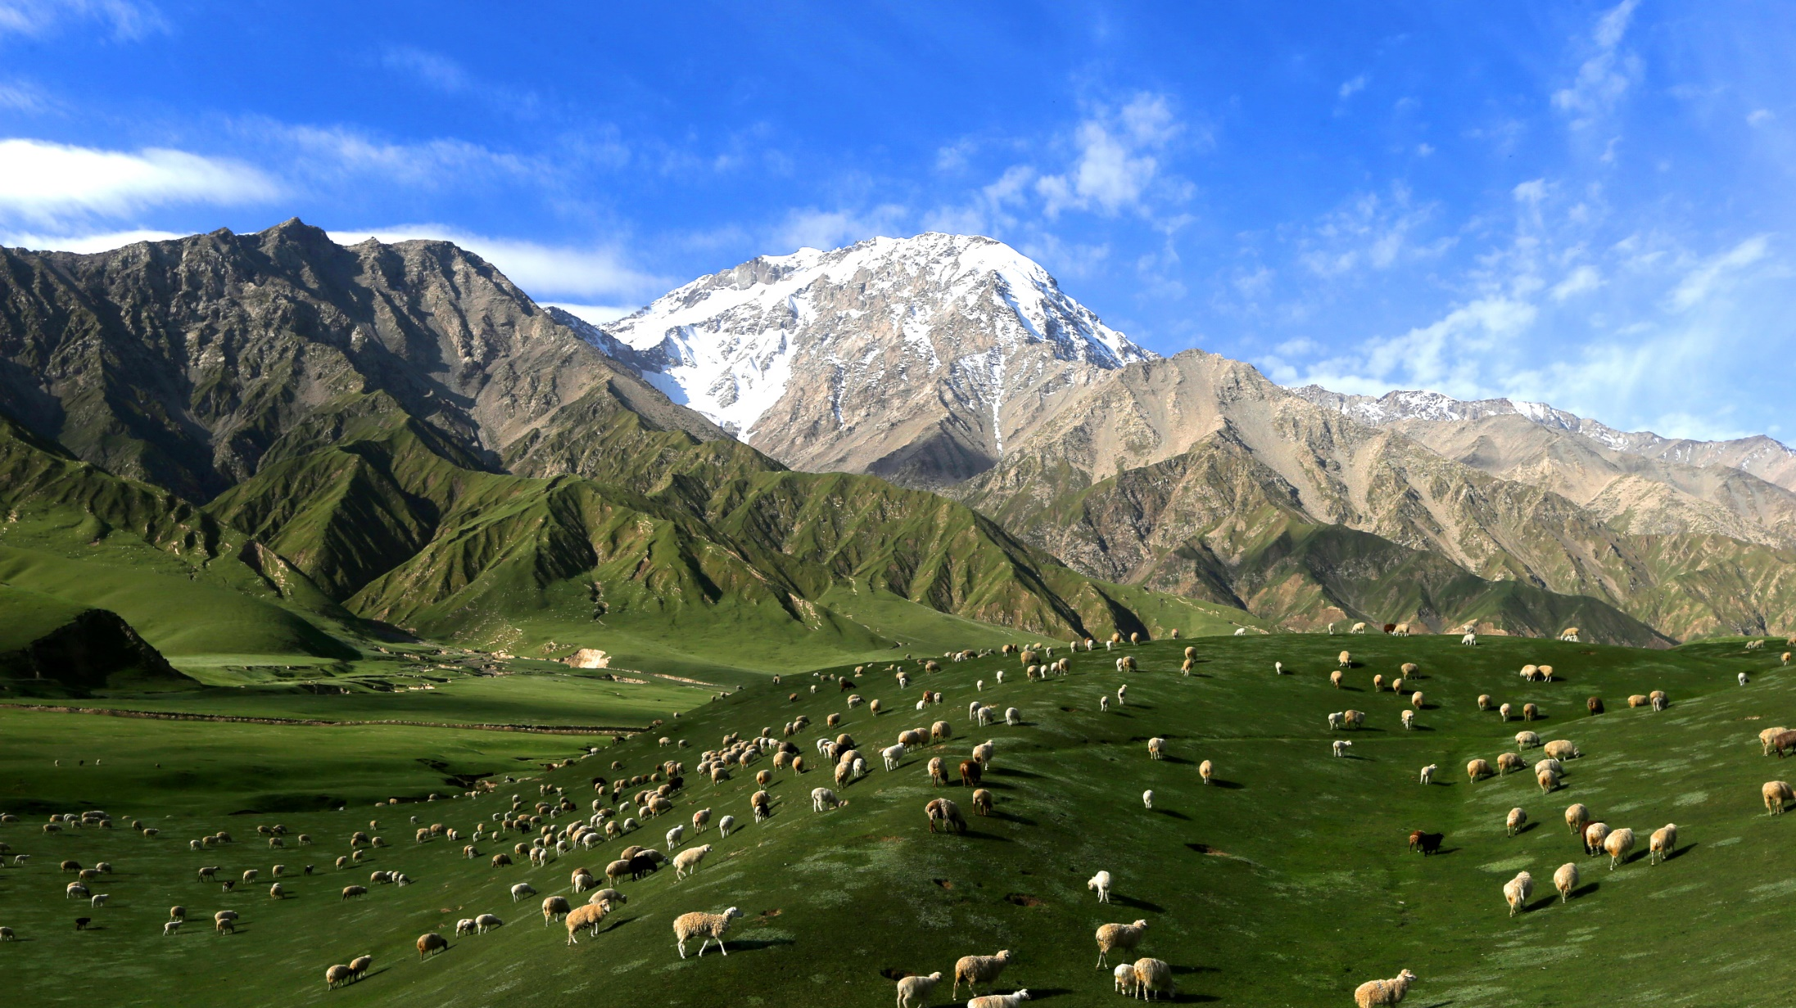
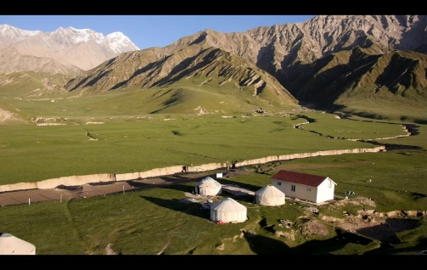
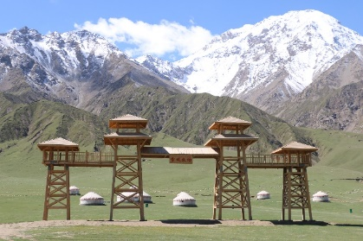
昆仑山大峡谷内冰川雪峰与高山草地垂直分布，气候瞬息变化，常常会出现百步不同的气候景象，天象和气候景观极为丰富。具有绚丽多姿的雪域草原风光，一路驰骋随着登顶亚门，沿途四季风光一览无余，日照充足，气候宜人，自然景观与人文景观并茂，雪山、草原、库里湖、雄鹰、羊群、五彩泉、木栈道、阁楼、牙门遗址与游牧文化融为一体。In the Kunlun Mountain Grand Canyon, glaciers, snow peaks and alpine grasslands are vertically distributed. The climate changes rapidly, and climate scenes that vary hundreds of steps often appear. The celestial phenomena and climate landscapes are extremely rich. It has splendid snow-covered grassland scenery. As you climb to the top of Yamen, you will have unobstructed views of the four seasons along the way. It has abundant sunshine, pleasant climate, natural and cultural landscapes, snow-capped mountains, grasslands, Lake Kuli, eagles, and sheep. The group, colorful spring, wooden plank road, attic, and Yamen ruins are integrated with the nomadic culture.

Slide 6
1
近年来，认真贯彻落实“绿水青山就是金山银山”的发展理念，以打造昆仑山大峡谷“全球低碳生态景区”为目标，将农事活动、自然风光、休闲娱乐、观光采摘、生态环境治理等一体推进，全面加强生态环境保护坚决打好污染防治攻坚战。
In recent years, has conscientiously implemented the development concept of "lucid waters and lush mountains are invaluable assets", with the goal of building the Kunlun Mountain Grand Canyon as a "global low-carbon ecological scenic spot", integrating agricultural activities, natural scenery, leisure and entertainment, sightseeing and picking, and ecological Environmental governance and other integrated activities will be promoted, and ecological and environmental protection will be comprehensively strengthened to resolutely fight against pollution.

Slide 7
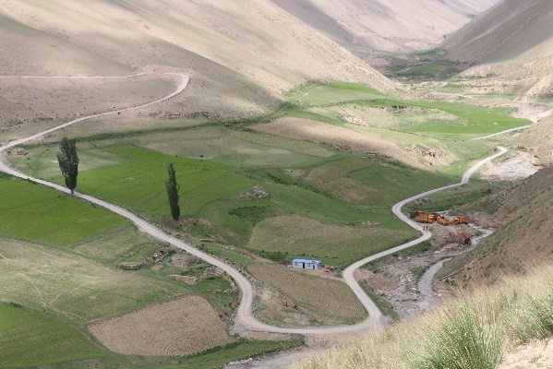
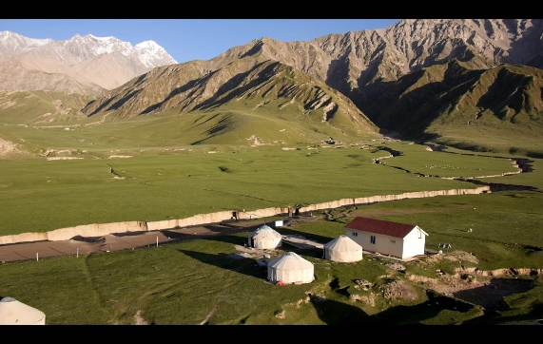
致力于发展为生态文化旅游综合体
Committed to developing into an ecological and cultural tourism complex

Slide 8
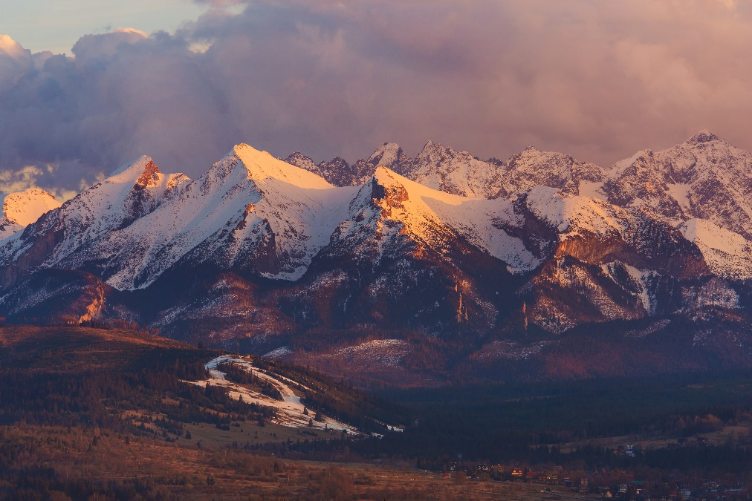
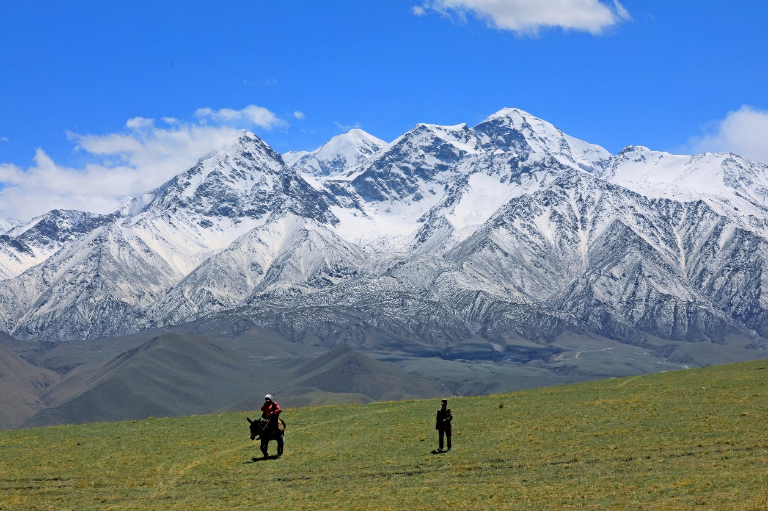
坚持绿水青山就是金山银山
Adhering to clear waters and green mountains is the golden and silver mountain

Slide 9
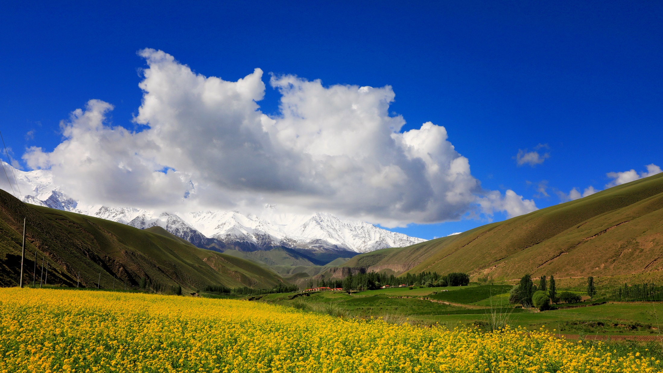
坚持绿水青山就是金山银山
Adhering to clear waters and green mountains is the golden and silver mountain

Slide 10
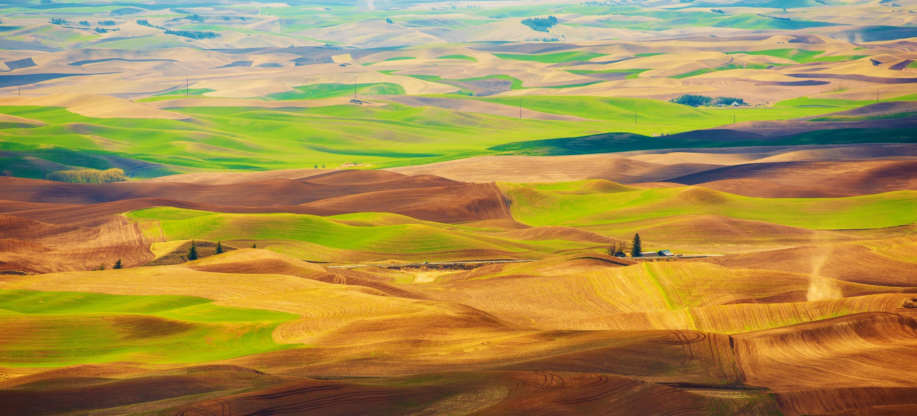
打造全国优秀生态景区
Create a national outstanding ecological scenic spot
以及低碳环保示范区
and low-carbon environmental protection demonstration area

Slide 11
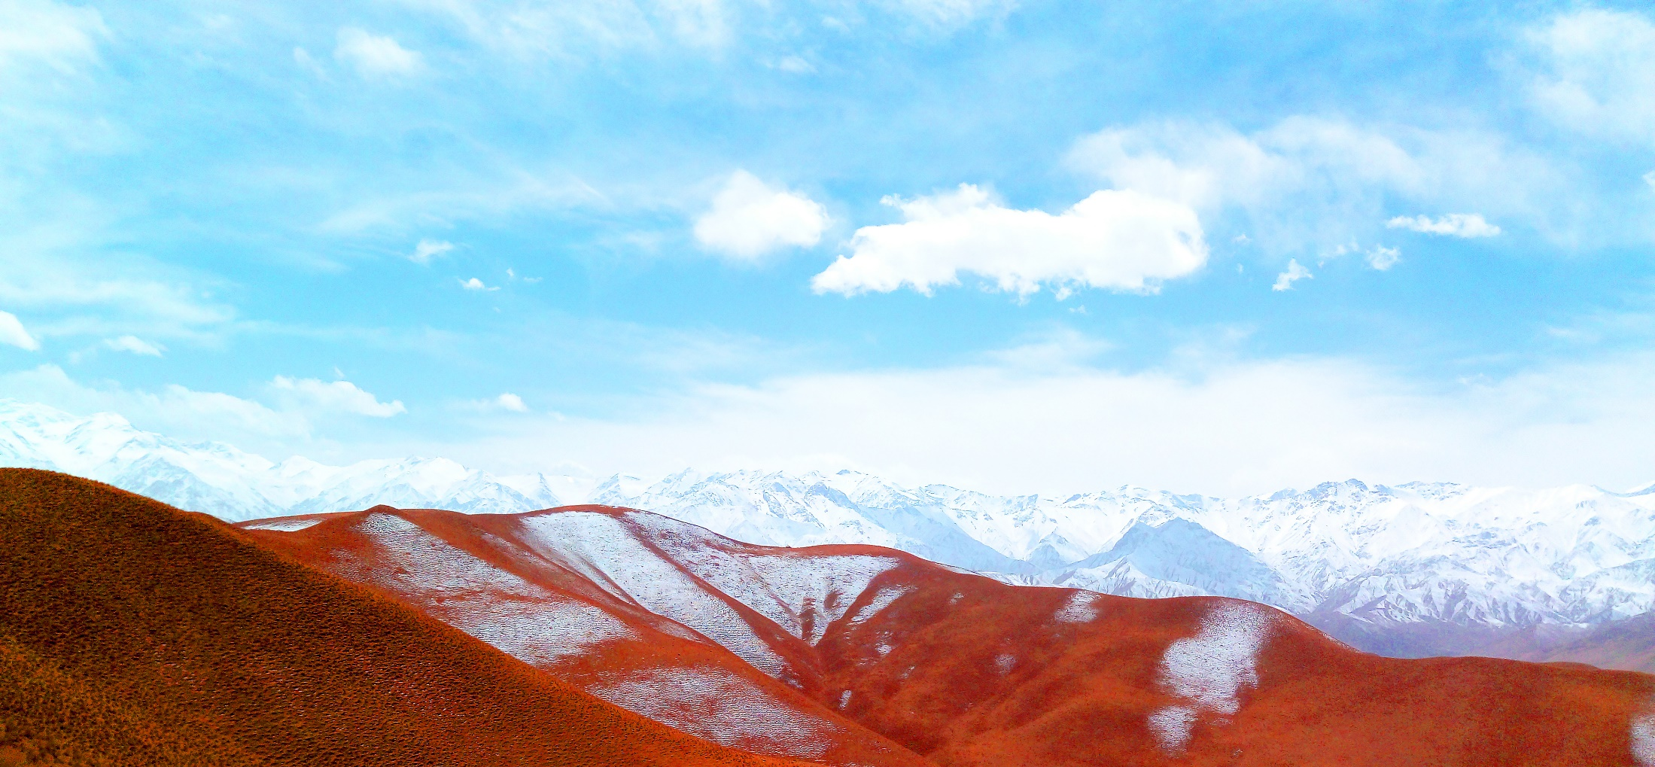
打造美丽低碳景区 Create beautiful low-carbon scenic spots

Slide 12
2
坚持以旅游产业规划为主的多规融合，将经济发展规划、城镇建设规划、产业发展规划与旅游规划有机结合起来，主要有以下特点
Adhere to the integration of multiple plans focusing on tourism industry planning, and organically combine economic development planning, urban construction planning, industrial development planning and tourism planning. The main characteristics are as follows:

Slide 13
一是在产业形态上，布局未来产业引领发展。充分尊重自然生态，把天然草原资源、生态系统、生物多样性都看作是最后的旅游资源加以严格保护和合理开发，拒绝高能耗、高污染项目落户景区
First, in terms of industrial form, lay out future industries to lead development. Fully respect the natural ecology, regard natural grassland resources, ecosystems, and biodiversity as the last tourism resources, strictly protect and rationally develop them, and reject high-energy-consuming and high-pollution projects from settling in scenic spots.

Slide 14
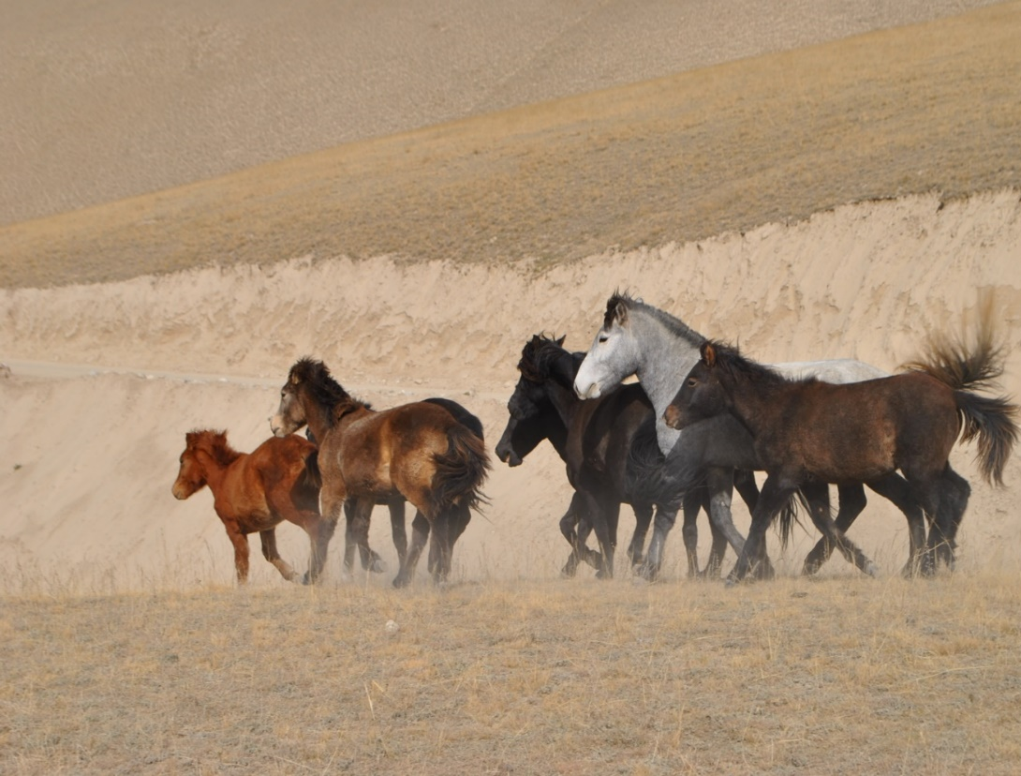
二是生态格局上，实现“天蓝、地绿、水清”的生态体系。景区空气负氧离子含量丰富。持续保护现状景区内的草原、草场，核心景区的草原覆盖率高。生活污水经生态处理，达标后排放。其他生活垃圾采用集中收集，定期外运，纳入到昆牧镇城镇固体废弃物处理系统中。
The second is to achieve an ecological system with “blue sky, green land, and clear water” in terms of ecological pattern. The air in the scenic area is rich in negative oxygen ions. Continue to protect the grasslands and pastures in the current scenic area, and the grassland coverage rate in the core scenic area is high. Domestic sewage is treated ecologically and discharged after meeting standards. Other domestic waste is collected centrally, transported out regularly, and incorporated into the urban solid waste treatment system of Kunmu Town.

Slide 15
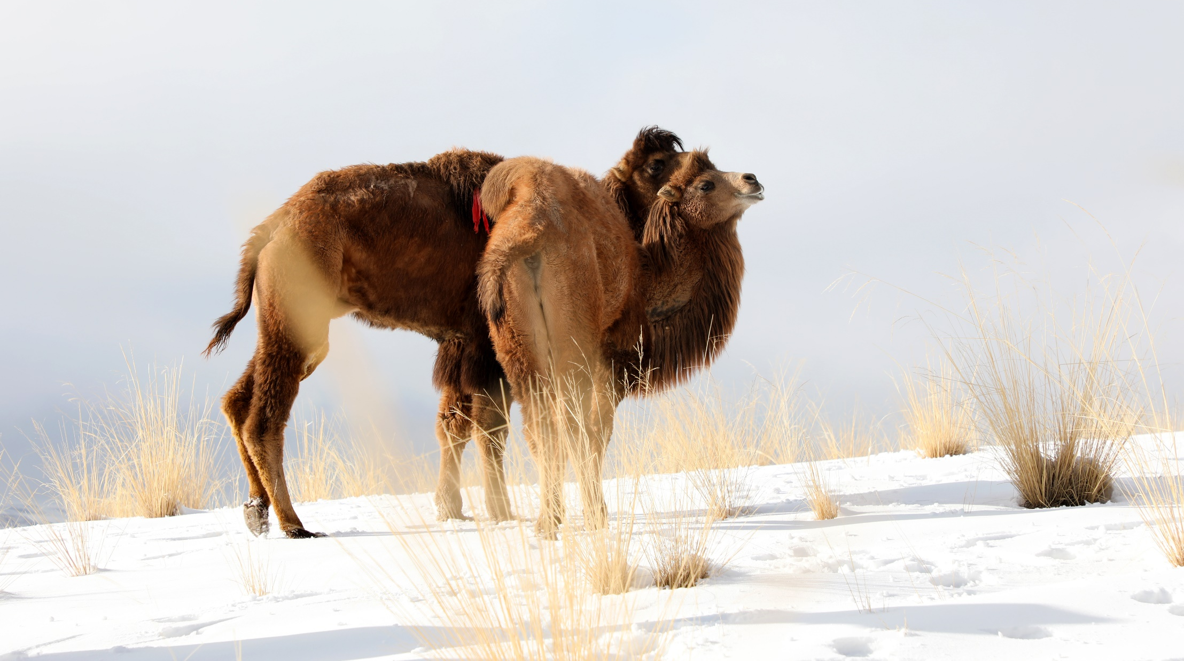
三是在野生动植物保护方面，对野生动植物生长环境进行监测和保护，减少人为改造环境，以免对野生动植物造成危害。组织开展《野生动物保护》等专项行动，及时对辖区内发生的非法挖掘、猎捕、收购、运输、经营野生动植物等各类违法犯罪活动进行严厉的打击处理。
The third is to protect wild animals and plants, monitor and protect the growth environment of wild animals and plants, and reduce artificial modification of the environment to avoid harm to wild animals and plants. Organize and carry out special operations such as "Wildlife Protection" to promptly and severely crack down on various illegal and criminal activities such as illegal excavation, hunting, acquisition, transportation, and management of wild animals and plants within the jurisdiction.

Slide 16
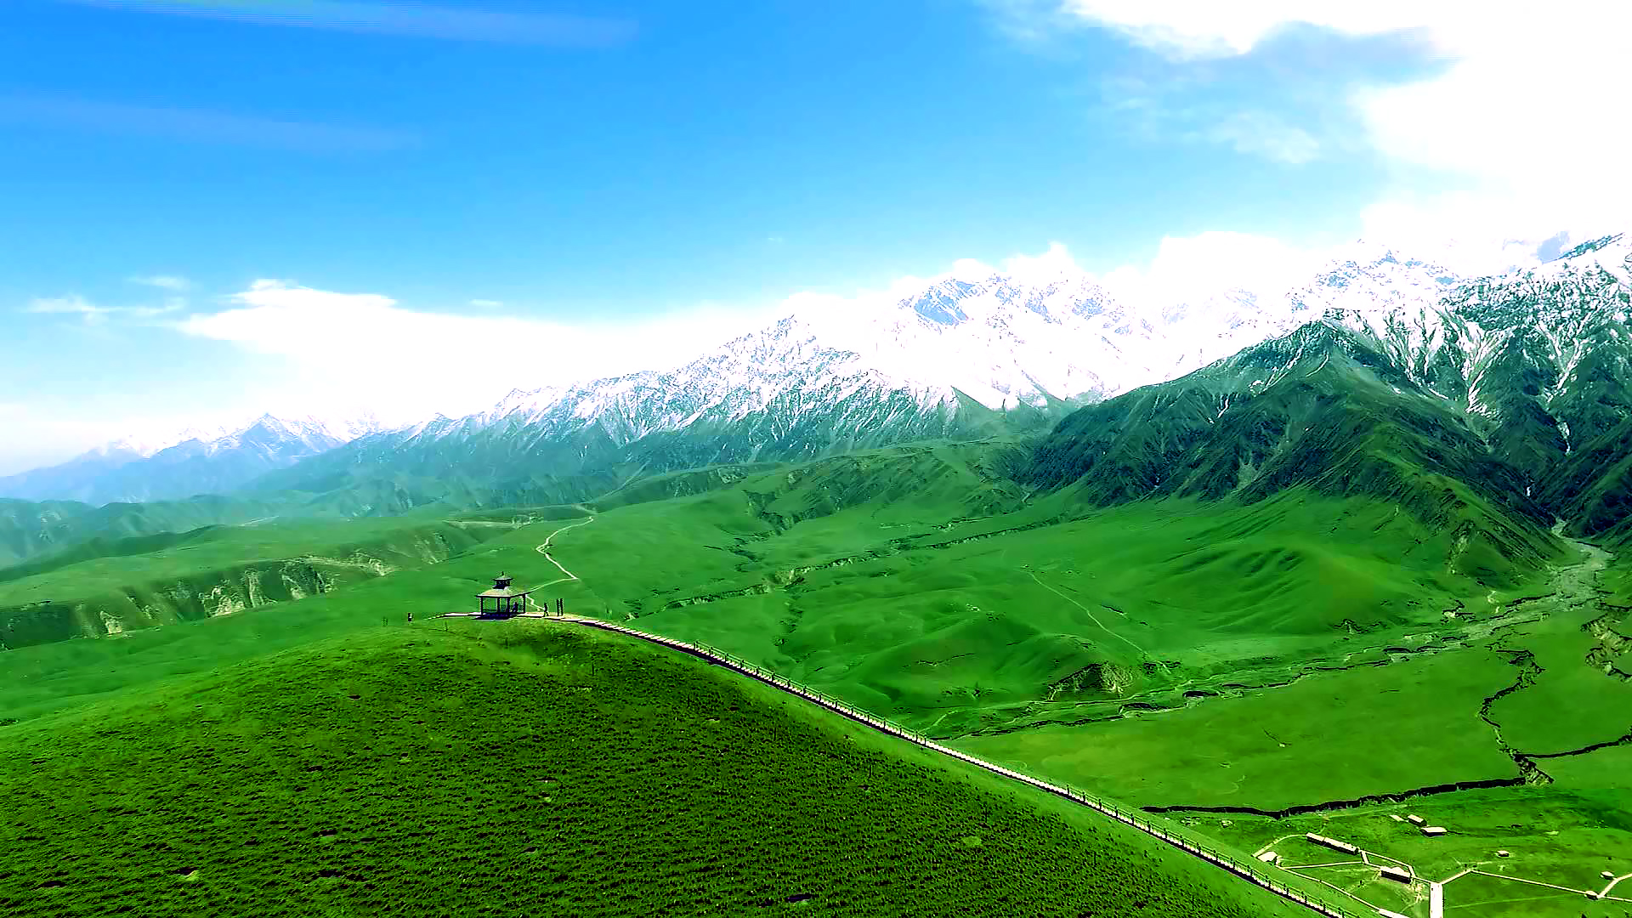
四是在低碳特色方面，具有突出的低碳特色，鼓励和引导辖区内企业、商家和居民使用节能产品和清洁能源。辖区内没有燃煤锅炉使用，清洁能源使用率高（目前，辖区使用的清洁能源主要有电能、天然气、太阳能等）。采暖全部使用电采暖。路灯采取太阳能供能率高。同时，利用节能宣传周和全国低碳日等活动向游客宣传减少酒店一次性用品的消耗。向游客、居民不断宣传、讲解保护环境、低碳出行的宣传知识。
Fourth, in terms of low-carbon features, it has outstanding low-carbon features and encourages and guides enterprises, businesses and residents within the jurisdiction to use energy-saving products and clean energy. There are no coal-fired boilers in use in the jurisdiction, and the utilization rate of clean energy is high (currently, the clean energy used in the jurisdiction mainly includes electricity, natural gas, solar energy, etc.). All heating uses electric heating. Street lights are powered by solar energy with high efficiency. At the same time, activities such as Energy Saving Promotion Week and National Low Carbon Day are used to promote the reduction of disposable supplies in hotels to tourists. Continuously promote and explain environmental protection and low-carbon travel knowledge to tourists and residents.

Slide 17
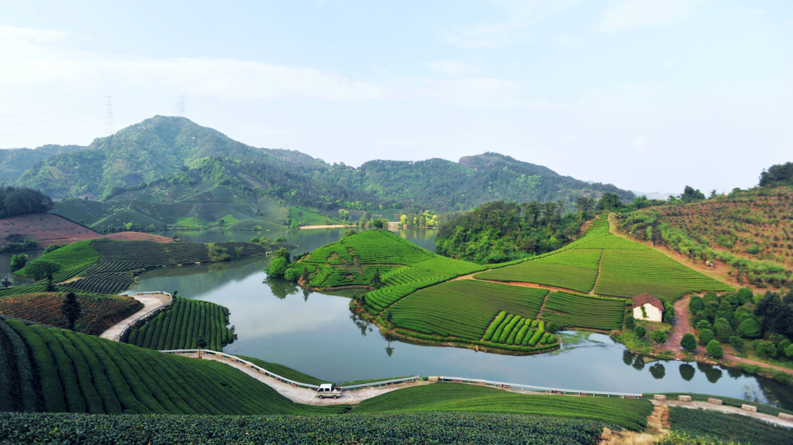
昆仑之门、雪域草原，昆仑山大峡谷景区深厚的历史文化积淀，丰富的生态资源，正朝着低碳景区的目标一路迈进。在此，诚挚地邀请世界各地的朋友来昆仑山大峡谷景区考察交流、投资兴业，共享绿色发展机遇，共结命运共同体，共绘一幅绿色低碳的恢弘画卷。
Gate of Kunlun, Snowy Grassland, the Kunlun Mountain Grand Canyon Scenic Spot has profound historical and cultural accumulation and rich ecological resources, and is moving towards the goal of a low-carbon scenic spot. Here, we sincerely invite friends from all over the world to come to the Kunlun Mountain Grand Canyon Scenic Area for inspection, exchange, investment and business, to share green development opportunities, to build a community with a shared future, and to paint a grand picture of green and low-carbon.

Slide 18
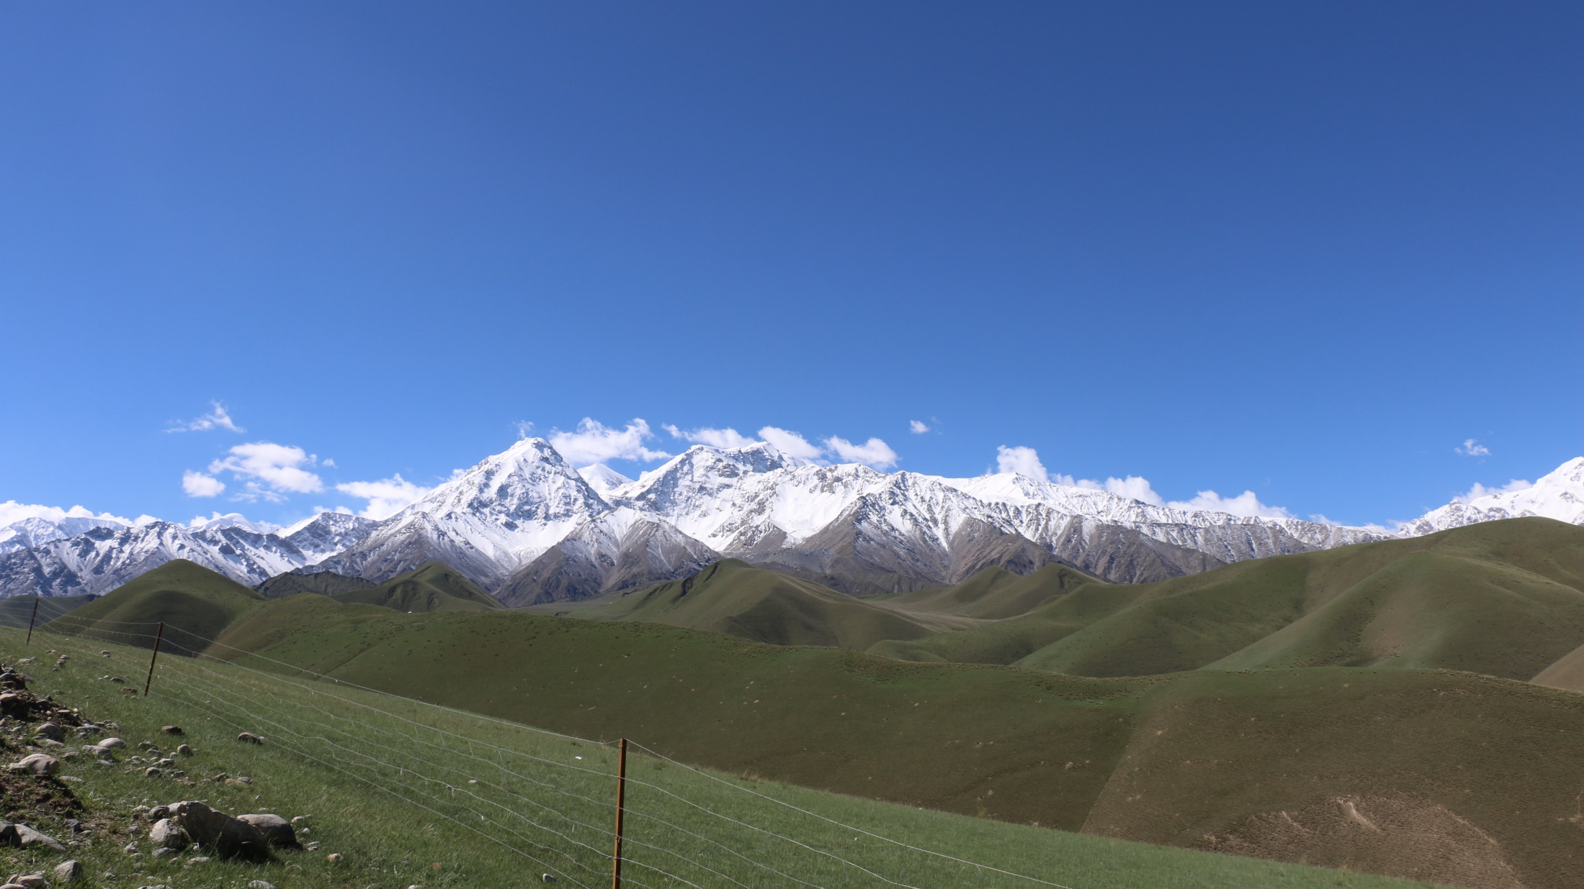
谢谢大家！

